Slide 1

Forensic Intelligence Unveiling Patterns and Trends
Team Members: Advika Kairamkonda Apoorva Reddy Nanabolu

Slide 2
OJECTIVES
Developing Predictive Models: Build machine learning models capable of accurately predicting criminal activity based on diverse features such as location, time, and demographics.
Optimizing Resource Allocation: Utilize predictive model insights to strategically deploy law enforcement resources, focusing efforts on high-risk areas and times to enhance crime prevention strategies effectively.
Evaluating Model Performance: Assess predictive model effectiveness using real-world data, comparing performance metrics to ensure reliability and inform decision-making for deploying the most effective crime prediction tools.
Identifying Crime Hotspots: Utilize predictive models to identify hotspots of criminal activity, enabling law enforcement agencies to prioritize patrols, surveillance, and intervention measures in areas most at risk.
Analyzing Crime Patterns: Gain a deeper understanding of crime patterns by analyzing historical data and extracting meaningful insights.

Slide 3
REQUIREMENTS
Python: The project will be developed using Python programming language and will utilize essential libraries such as pandas, numpy, matplotlib, and scikit-learn for data manipulation, analysis and visualization
Data Preprocessing: The code will incorporate data preprocessing techniques to clean, transform, and prepare the data for modeling and tuning.
Evaluation: The code will implement evaluation techniques to assess the performance of the predictive models.

Slide 4
APPROACH
Data Collection
Data Preprocessing
Data Splitting
Model Evaluation
Model Tuning
Model building
Prediction

Slide 5
Random Forest Algorithm
Versatility: Random Forest is effective for both classification and regression tasks, making it suitable for predicting criminal activity based on features like location, time, and demographics.
Robustness: It can handle large datasets with high dimensionality and noisy features, making it suitable for analyzing crime data.
Reduced Overfitting: Random Forest's use of random subsets of data and features reduces the risk of overfitting compared to other decision tree-based algorithms, improving generalization performance.
Comparative Advantage: Random Forest outperforms other models like logistic regression and decision trees in crime analysis due to its ensemble approach, which combines multiple decision trees' predictions. This often leads to higher accuracy, especially with complex datasets and when dealing with noisy features.

Slide 6
DELIVERABLES
Machine Learning Model
A model capable of accurately predicting criminal activity based on factors like location, time, and demographics, developed using Python and libraries like scikit-learn.
Methodology Report
A detailed report explaining the methodology used in model development, including data preprocessing techniques, model hyperparameters, and evaluation metrics.

Slide 7

EVALUATION METHODOLOGY
Performance Metrics
The predictive performance of the Random Forest model will be assessed using metrics such as accuracy, precision, recall, F1-score.

Slide 8
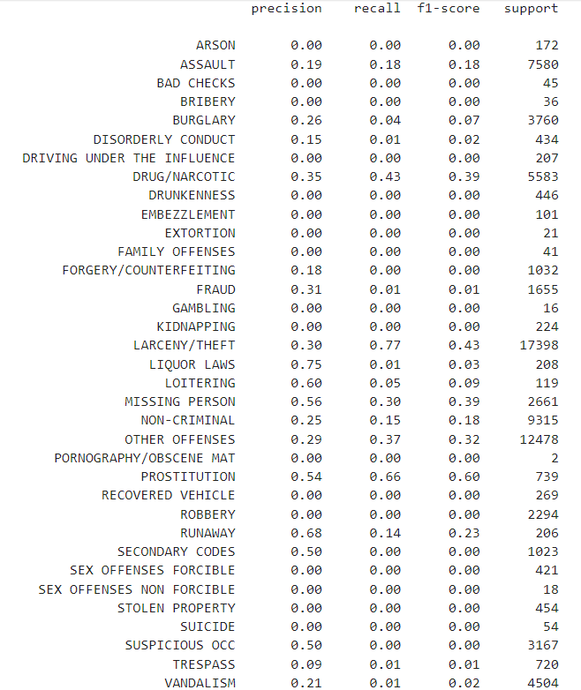
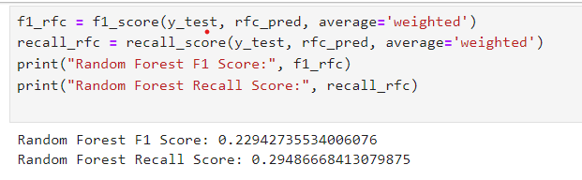
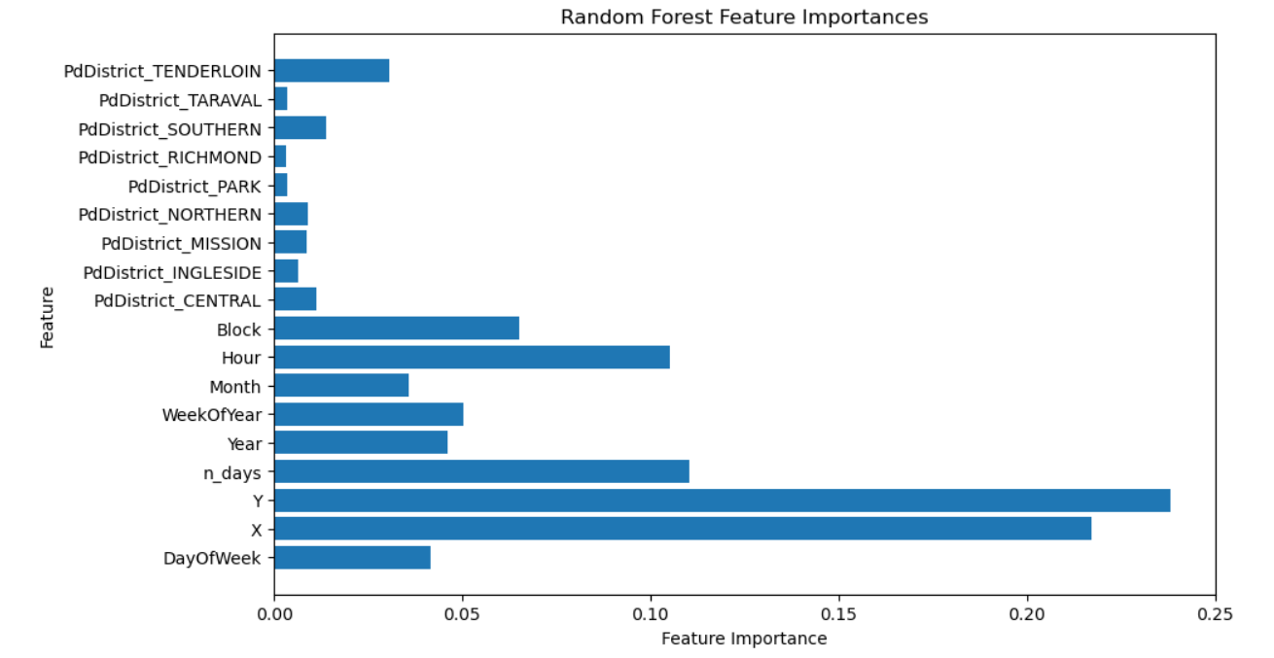
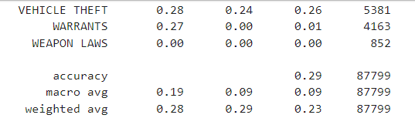
Results

Slide 9


